Slide 1
Mantid Release Presentation
Release 3.7
ISIS

Slide 2
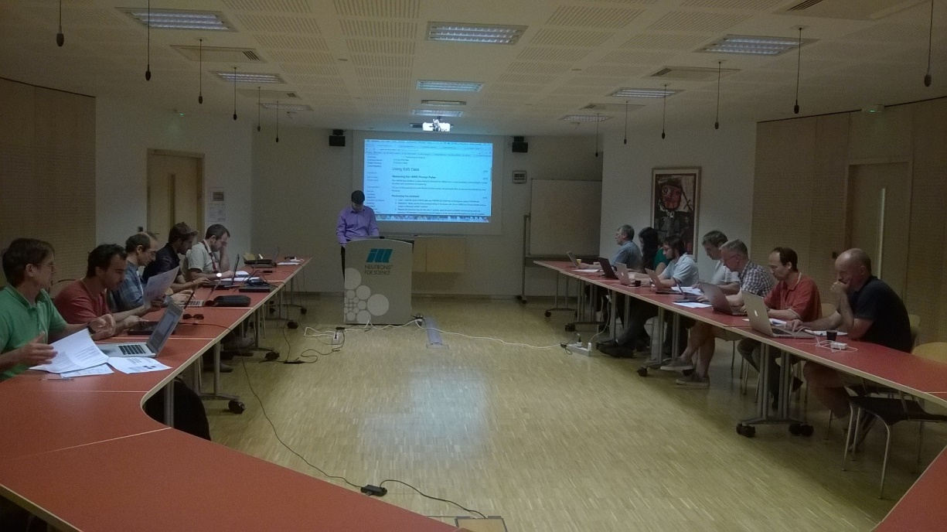
Training Courses
Dates
Last Course
April 2016
Next courses
?October 2016
To Book
Email: nick.draper@stfc.ac.uk
More details at www.mantidproject.org

Slide 3








Supported Platforms
Staying the same
RHEL 6 64bit
RHEL 7 64bit
OSX Mavericks +
Windows 7 64 bit
Ubuntu 14.04 64 bit
Limited support for
Windows 8 64 bit
Fedora 20
Windows 10

Slide 4
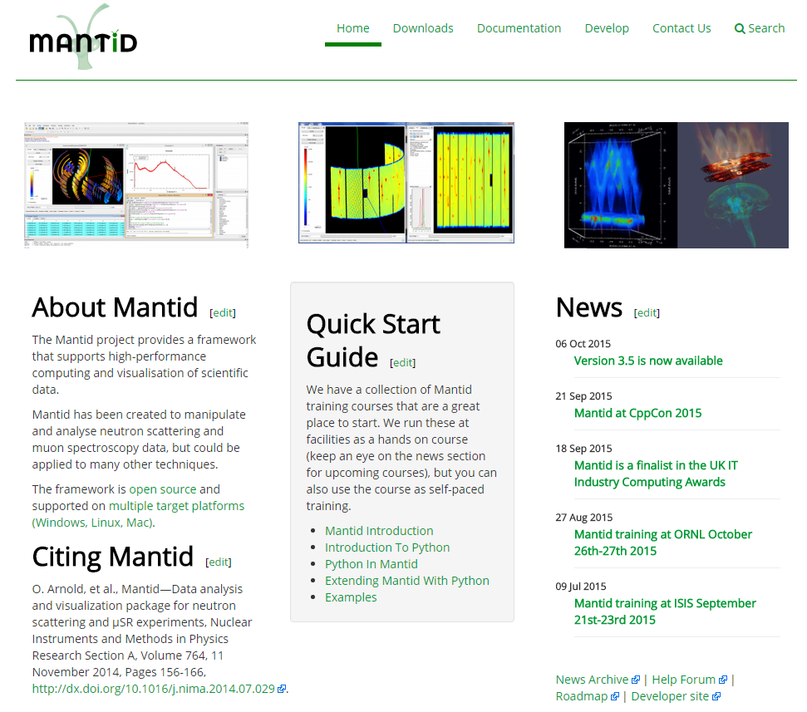
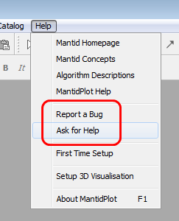
Mantid Support Forum
forum.mantidproject.org
help.mantidproject.org

Slide 5
Framework

Slide 6
Script Repository
Fixed crash on Mac OSX when trying to retrieve proxy information at RAL
ISIS Mac users: Please remove “proxy.info=“ & “proxy.port=” lines from /Users/LOGIN/.mantid/Mantid.user.properties file
Fixed bug that caused uploads to fail with some incorrectly configured proxy servers
The default download timeout has been increased from 5s to 30s to avoid hitting the timeout when tying to download some larger files

Slide 7
Python
The Atom class, which stores the cross-sections, relative atomic masses, and other information for all elements and isotopes is now accessible from Python.
The Material class has two new Python methods: chemicalFormula returns a tuple of Atom objects corresponding to the atoms in the compound, and their abundances; relativeMolecularMass returns the relative formula unit mass in atomic mass units.
The plot() function of mantidplot.pyplot now supports empty marker (marker=None).
V3D is now iterable in Python, which makes it possible to easily construct numpy arrays like this np.array(V3D(1,2, 3)).
Two new attributes available on all python algorithms startProgress and endProgress. Added to an algorithm call, it will allow for passing control of the progress bar to child algorithms.

Slide 8
User Interface

Slide 9
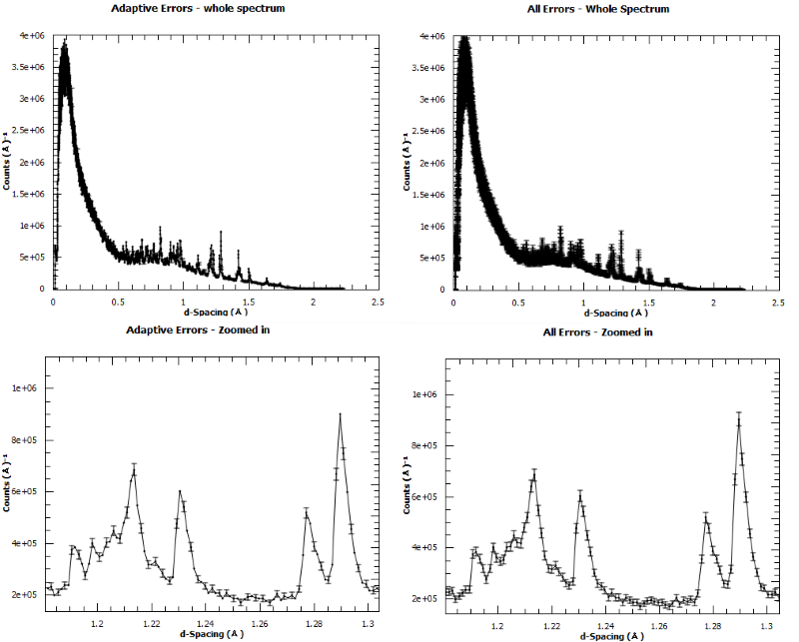
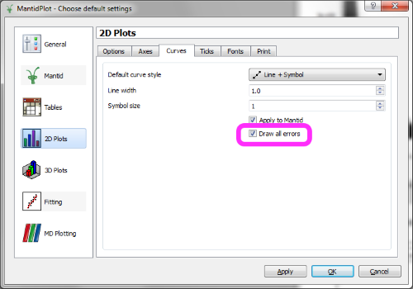
Line Plots
Graphs now show ALL error bars
Previously skipped some points based on the data density.
It can make dense data plots with errors look more obscured.
You can change it back by unselecting the option Draw All Errors in the View⇒Preferences menu

Slide 10
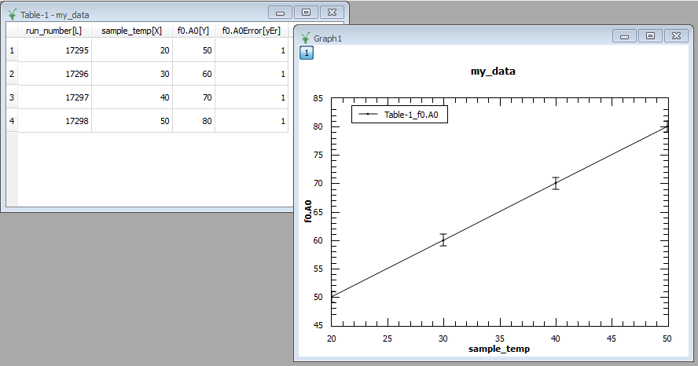
Others
Instrument View
Is now separated from MantidPlot so it can be used in other interfaces, and directly from python.
Bugs resolved
Many bugs have been fixed, particularly in:
Plotting from tables
Multi-dataset fitting
VSI

Slide 11
Documentation
Improvements for Nexus loading algorithms
Details the link between file structure and usage in Mantid.
The various calibration approaches have been documented in a single location under concepts.
The Bspline and Cubic spline are better documented, and have usage examples.
The various minimisers have been documented and evaluated against NIST standard problems.

Slide 12
Muon

Slide 13
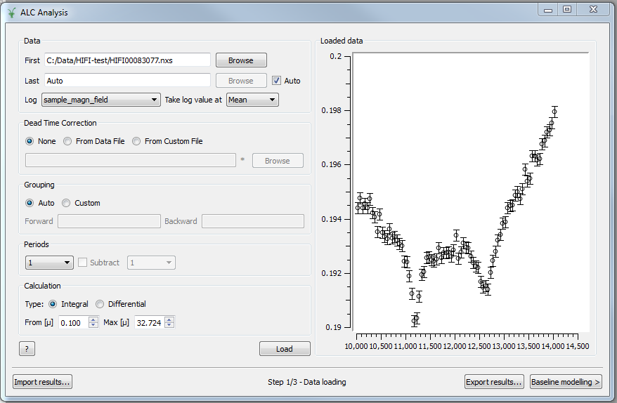
Muon ALC
Fixed crash and (slightly) improved performance
Defaults to same directory as first run
Moved and renamed
Loads grouping from IDF if not present in file
Don’t reset when a new first run is loaded
First good data (not first bin)

Slide 14
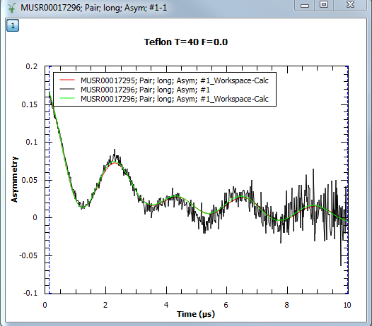
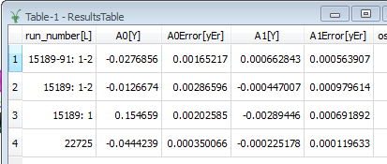
Muon Analysis
Old fits (and guess) kept when new data loaded
Must manually clear old fits
To do: add option for how many to keep (default 1?)
Run numbers in results table now show periods (if multiple)
“Run information” improved for co-added runs
Several bugs fixed, including:
Plot/remove guess
Display parameter errors
Sequential fitting error messages
Crash loading data on Linux
Current data for ARGUS
Resizing window on small screens
Loading new run for same instrument, but different field direction – correct grouping

Slide 15
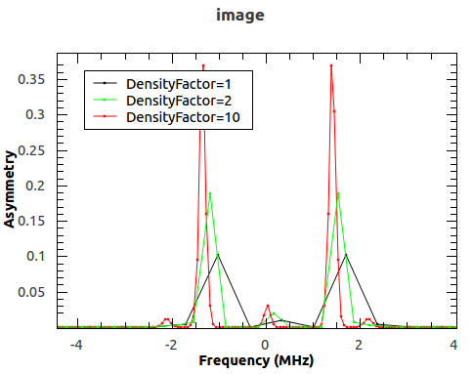
Muon algorithms and fit functions
CalMuonDetectorPhases speed increased
FFT and MaxEnt: X rounding errors and phase shift
MaxEnt: handles positive images, ability to increase number of points in image and reconstructed data, output labels
Keren fit function added (currently testing)

Slide 16
Future work (Roadmap)
Simultaneous fits in Muon Analysis interface
Target 3.8
Plotting improvements (overlay, tiled, Squash)
Waterfall plots for multi-histogram plotting
Frequency domain GUI
Target 3.9
Export to Origin
Target 3.9
Integration with calculated muon stopping sites (SINE2020)
Target 3.9

Slide 17
Next Release
Release v3.8
Planned Release Date: 10th October 2016

Slide 18

Thank you

